Slide 1

Intro To Raspberry Pi
UTA EE Workshops

Slide 2
The slides and code are here:
www.github.com/EELabMan
Please download the slide to follow along

Slide 3
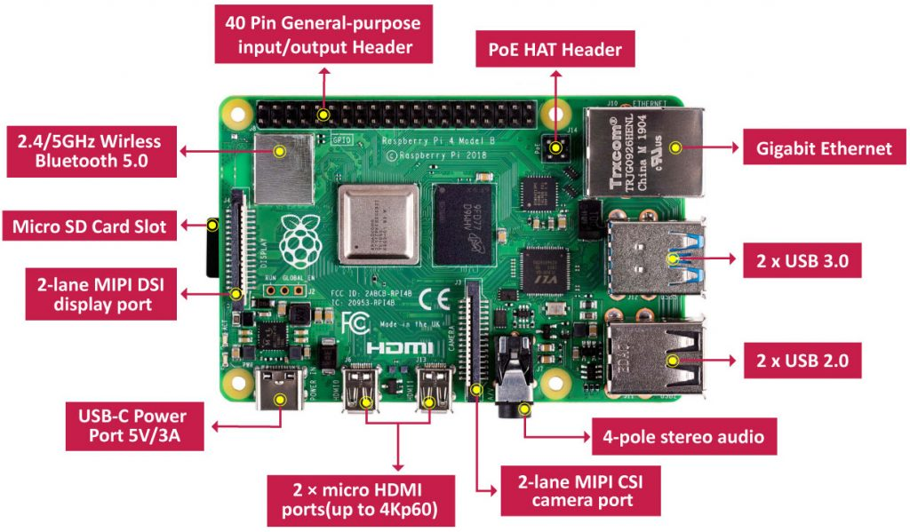
What is a Raspberry Pi?
The Raspberry Pi is a very, very small computer.
You can connect camera, speakers, displays, etc.
It comes with Wifi and Bluetooth built-in.

Slide 4
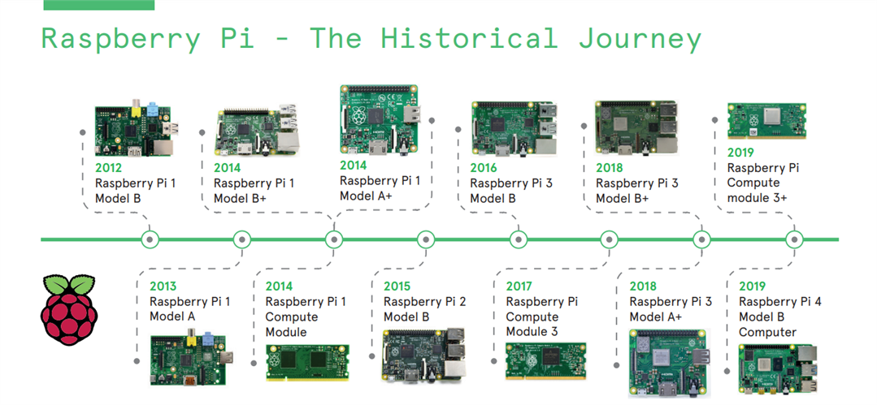
Raspberry Pi Versions

Slide 5
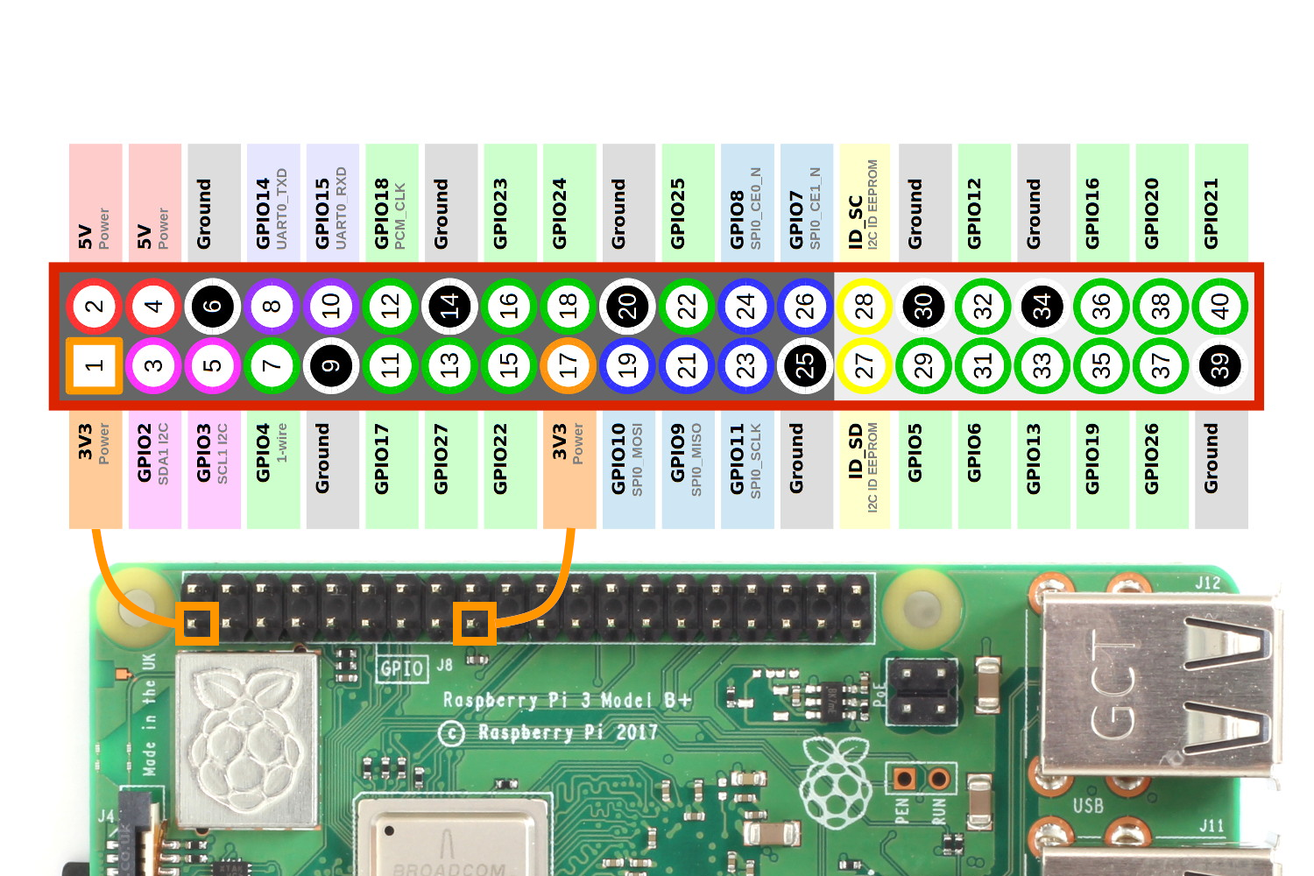
Raspberry Pi Pinout
The Raspberry’s 40 pin header make it unique.
You can add sensors, motors, servo’s, LED’s and much more to it and control the inputs and out outputs with code.
Pin Numbers and GPIO numbers are different.

Slide 6
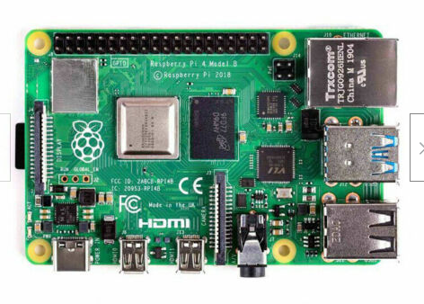
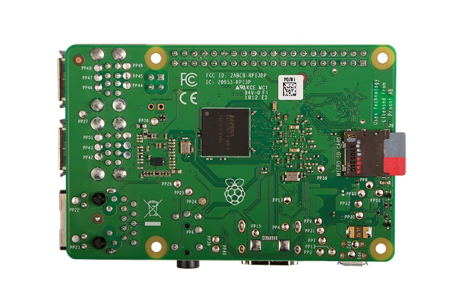
Raspberry Pi – Easy to short circuit the bottom pins
Wrist-straps not required but touch metal on the Rpi USB to dissipate ESD.
Never place bare board on metal surface.
Be careful not to touch the 40 pin header with any metal also.

Slide 7
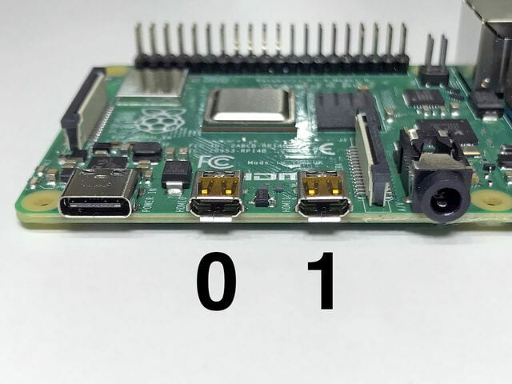
Connect Mouse, Keyboard and HDMI
Be gentle
RPi 4 will need the HDMI to HDMI Micro adapter. Plug into HDMI 0.
You will need to plug the HDMI into one of the lab monitors and change the input to HDMI. Let us know if you need help.

Slide 8
Connect Network Cable
Disconnect the network cable from the back of the bench to the computer and plug in the 7 foot network cable into that network port and the RPi.

Slide 9
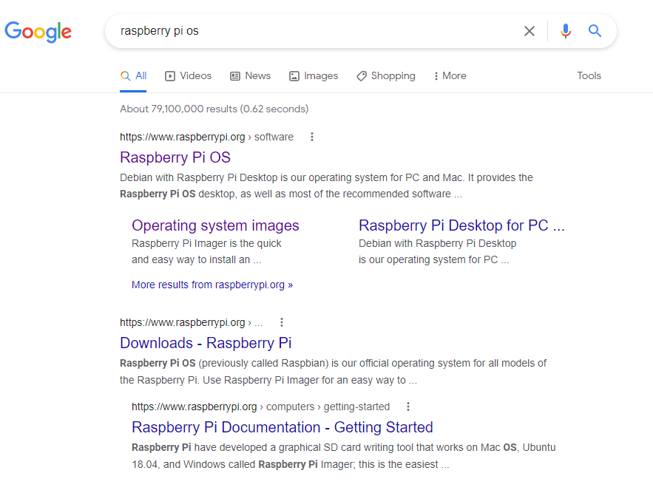
How to format the SD card
Search for Raspberry Pi OS

Slide 10
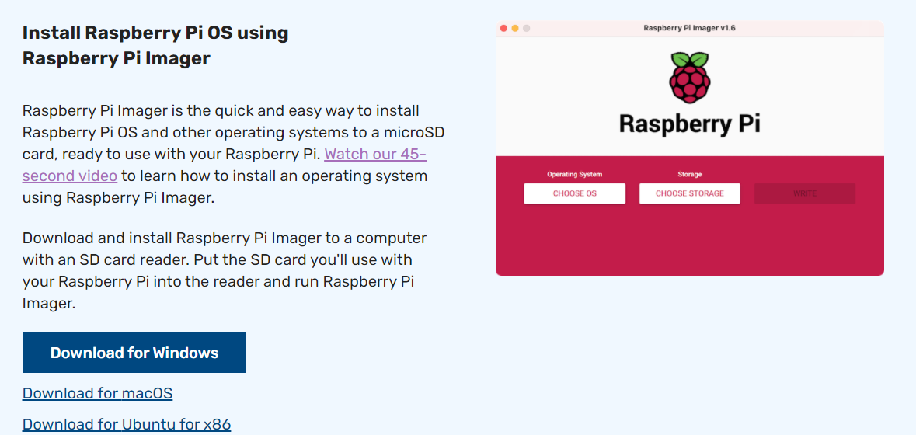
Download the installer for your system
This will install the latest SW
You have to download a huge file for previous versions.

Slide 11
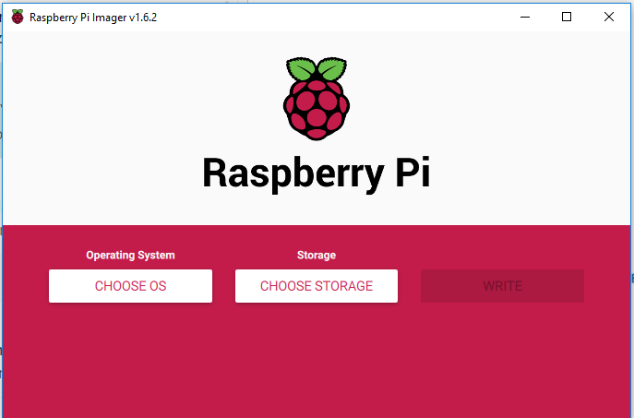
Open Raspberry Pi Imager

Slide 12
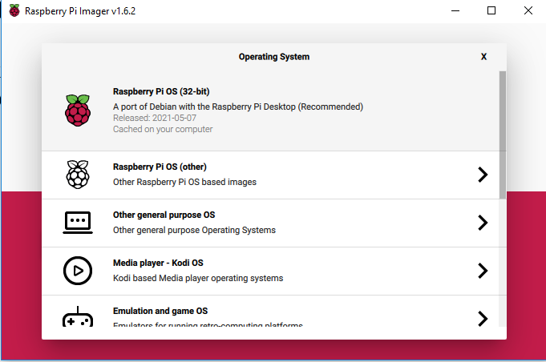
Choose the Raspberry Pi OS (32-bit)

Slide 13
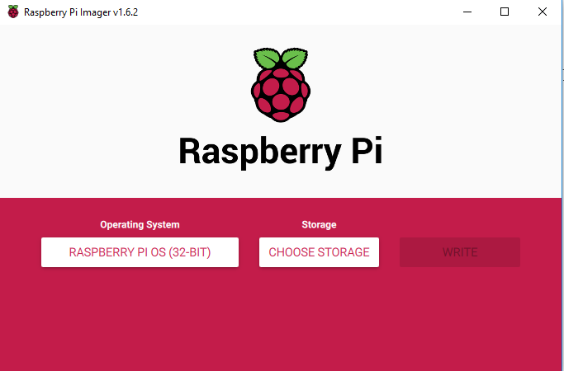
Plug the SD card into your computer and select Choose Storage.

Slide 14
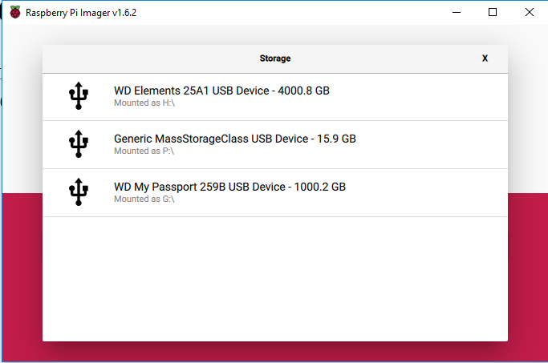
SD card is P:\ on this system. Verify in Explorer. THIS WILL ERASE EVERYTHING ON THE CARD

Slide 15
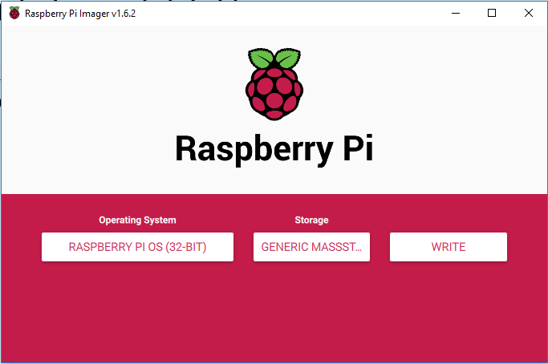
Click Write

Slide 16
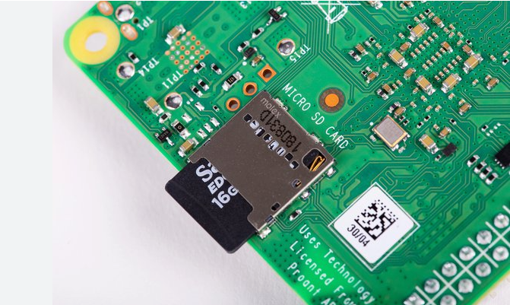
Insert the Imaged SD card into the Raspberry pi
Be gentle.

Slide 17
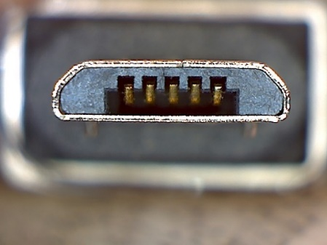

Connect Power
Again Gentle.
3B+ has directional USB Micro.
Rpi 4 has USB C and can plug in either way.
Ensure the Display is on HDMI input then
Once the pi completely boots up: wait before proceeding.
USB - Micro
USB - C

Slide 18
Connect Power
Go thru the set up. Chicago TimeZone,
Username is: pi
Password is: raspberry
This is the standard username and password.
DO NOT INSTALL UPDATES!
USB - C

Slide 19
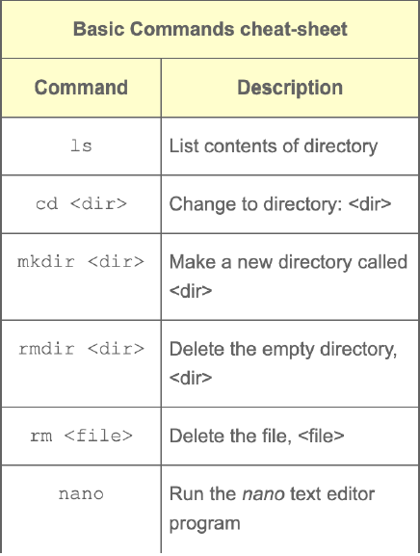
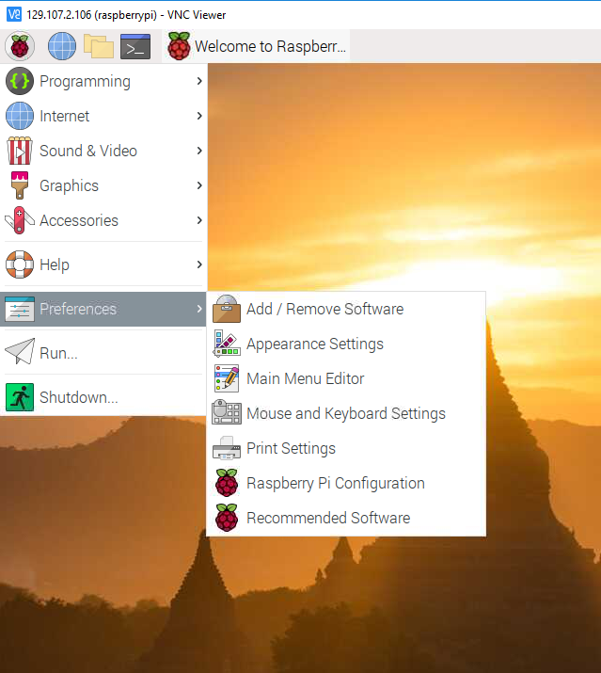
Terminal Commands
Open the Terminal window >_
This is Linux command prompt
Let’s see what these commands do

Slide 20
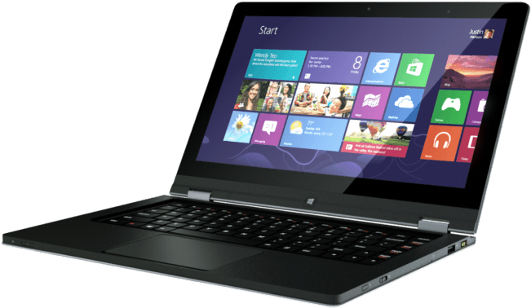
Don’t want a display, keyboard or mouse duct taped to your project?
Real VNC
Download https://www.realvnc.com/en/connect/download/viewer/ and install on your computer (not the Pi)

Slide 21
Don’t want a display, keyboard or mouse duct taped to your project?
On the Pi: Preferences -> Raspberry Pi configuration. Interfaces Tab: Enable VNC.

Slide 22
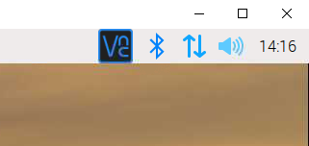
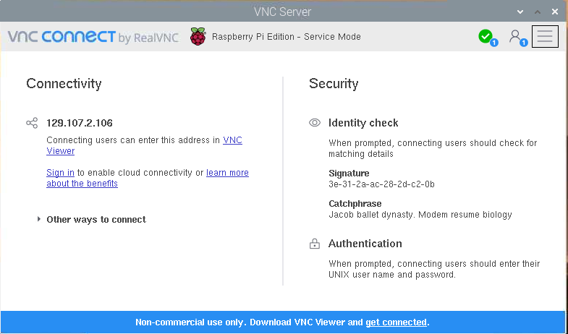
Remote control !
Click the VNC button in the upper right
This will give you the Pi’s IP Address.
Open Real VNC on your laptop and enter the address.
Computer name is pi and default password is raspberry.
This should allow you to remotely control the raspberry Pi.

Slide 23
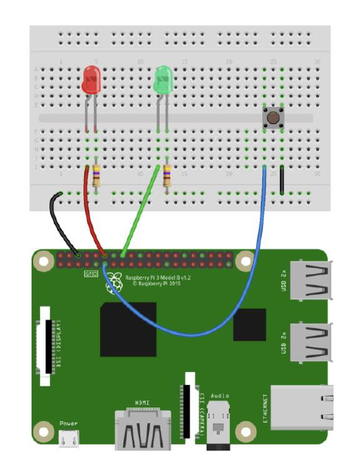
Blink LED’s in Python.

Slide 24
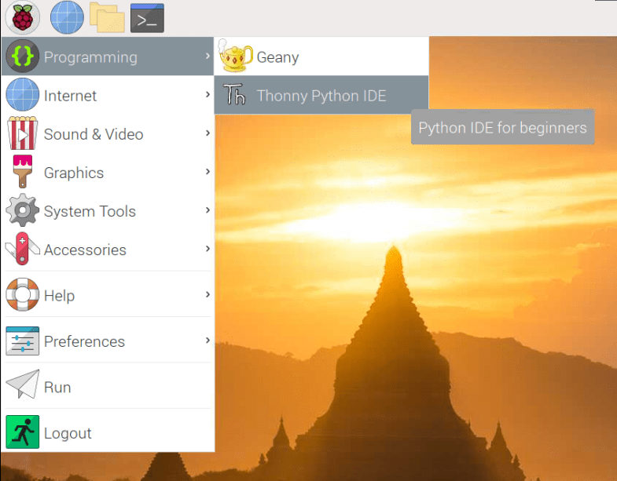
Open Thonny from the programming menu
Download the Button Blink code.py code from the GitHub page and paste it into Thonny.
Save the file as Button Blink code.py
The interesting fact is that the programming language Python was implemented by Guido van Rossum.
Whilst Guido van Rossum was implementing Python, he was also reading the published scripts from Monty Python’s Flying Circus.

Slide 25
Button Blink PWM code.py
try: while 1: if GPIO.input(butPin): GPIO.output(18, GPIO.HIGH) GPIO.output(23, GPIO.LOW) sleep(.2) GPIO.output(18, GPIO.LOW) GPIO.output(23, GPIO.HIGH) sleep(.2) #Pressed else: GPIO.output(18, GPIO.LOW) GPIO.output(23, GPIO.HIGH) sleep(1) GPIO.output(18, GPIO.HIGH) GPIO.output(23, GPIO.LOW) sleep(1) except KeyboardInterrupt: GPIO.cleanup()
import RPi.GPIO as GPIO import sys from time import sleep butPin = 17 GPIO.setwarnings(False) GPIO.setmode(GPIO.BCM) # GPIO.BOARD to reference pin numbers GPIO.setup(18, GPIO.OUT) GPIO.setup(23, GPIO.OUT) GPIO.setup(butPin, GPIO.IN, pull_up_down=GPIO.PUD_UP)
Notes:
# https://sourceforge.net/p/raspberry-gpio-python/wiki/Examples/
GPIO.Board will refer to the pins

Slide 26
Stay tuned
In the Second Raspberry Pi workshop we will build a Sound Board and do more Python programming…

